Slide 1
Lecture 4 Applying cutoffs for seropositivity
May 22, 2025
Seroanalytics Training Blantyre, Malawi

Slide 2
Lecture outline:
Apply different methods for cutoffs:
Mean + SD of negative controls
ROC curves
Mixture model

Slide 3
Unexposed controls
This can use negative controls from non-endemic region or from young controls (presumed unexposed)
Assumption: negative controls are normally distributed
Cutoff = mean + 2 or 3 standard deviations
According to normal distributions:
Only ~2.5% of negatives will be above mean + 2SDs
Only ~0.14% of negatives will be above mean + 3SDs
Notes:
Advantage: only requires negative controls, which may be easier to obtain than positive controls, especially for rare diseases

Slide 4
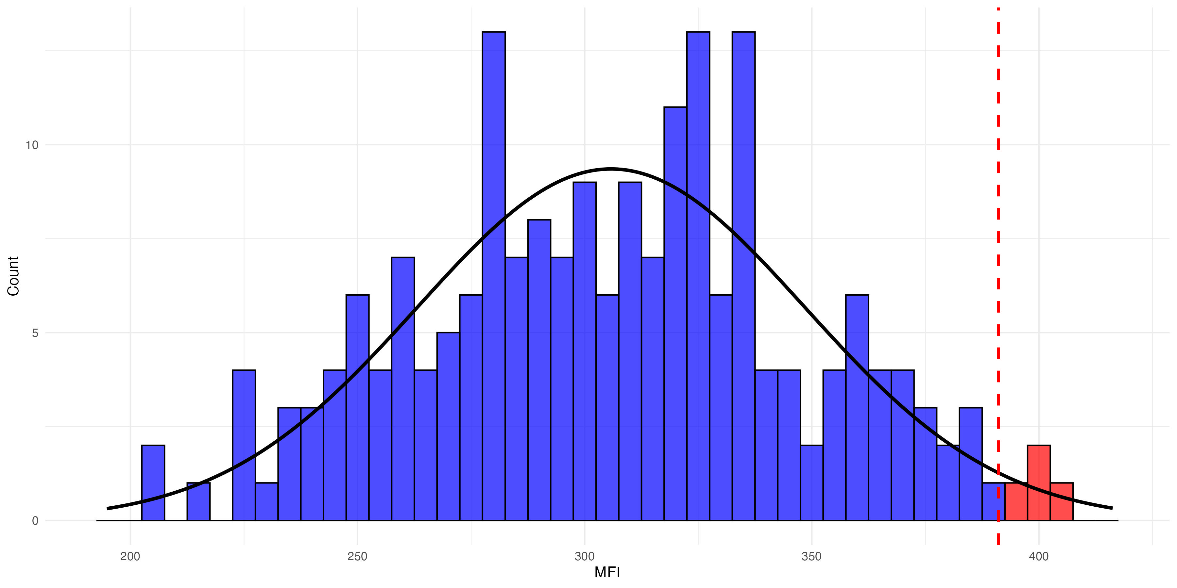
Unexposed controls
For mean + 2 SDs, ~2.5% of negative samples will be above cutoff

Slide 5
Unexposed distributions
Advantages:
Simple to implement
Doesn’t require positive controls
Disadvantages:
Negative controls must be comparable to true negative samples in population
Controls must be normally distributed (otherwise might have more false positives)
Could result in false negatives if there is overlap between distributions of true positives and negatives
Notes:
Advantages
Simple to implement
Disadvantages
Only works if controls are normally distributed, or could have larger numbers above cutoff by chance
Requires negative controls to be comparable to true negative samples in population
Could result in false negatives if there is overlap between true positives and normal distribution of negatives

Slide 6
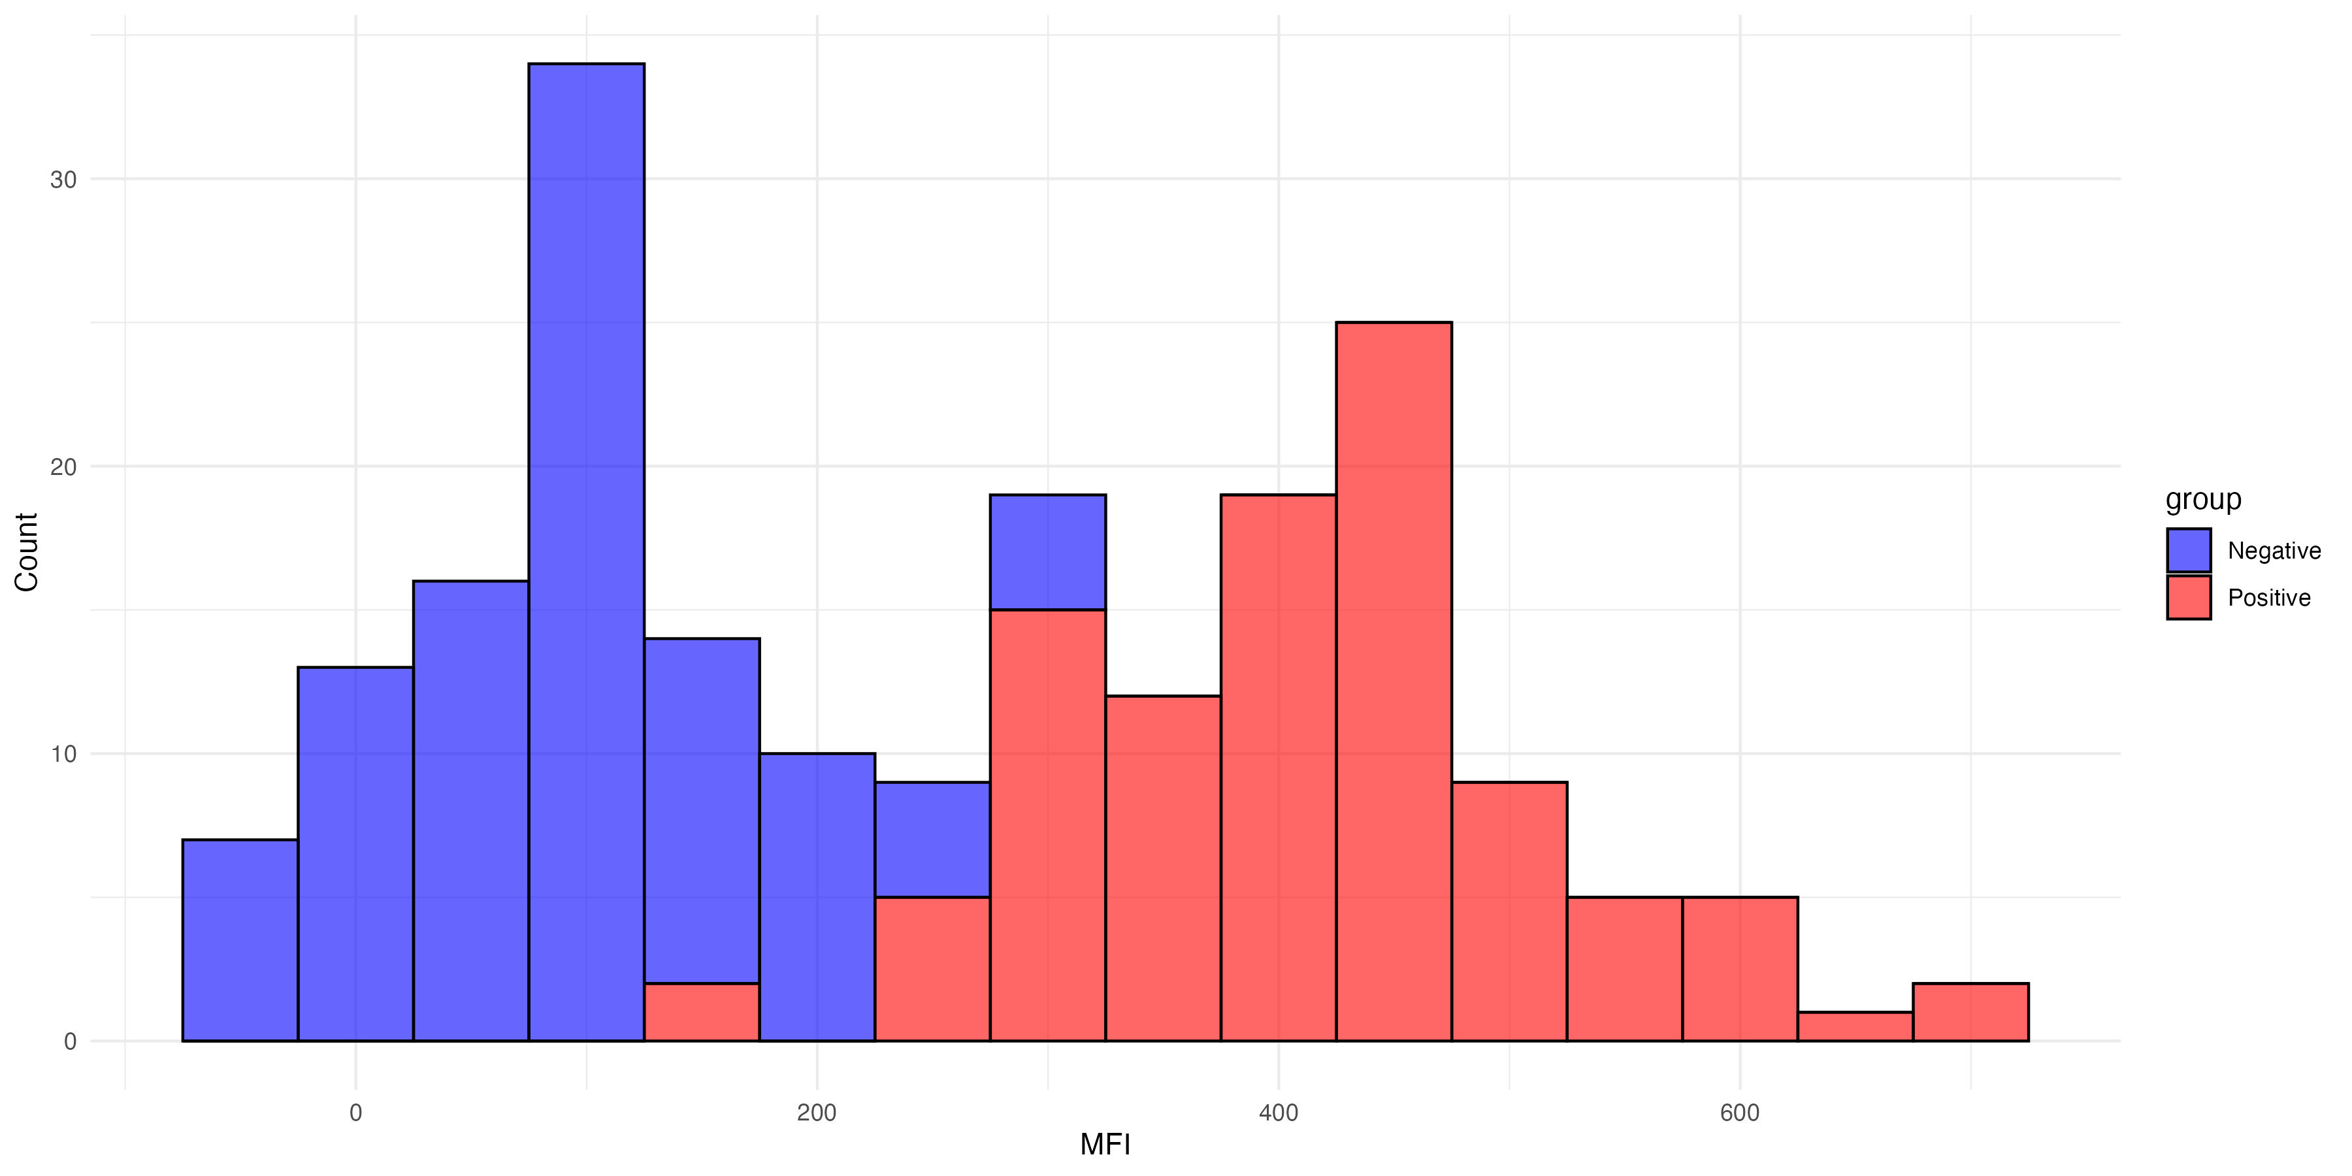
Unexposed distributions
Overlap between distributions of true positives and negatives
Notes:
Advantages
Simple to implement
Disadvantages
Only works if controls are normally distributed, or could have larger numbers above cutoff by chance
Requires negative controls to be comparable to true negative samples in population
Could result in false negatives if there is overlap between true positives and normal distribution of negatives

Slide 7
R code to implement method
Notes:
R code demo:
neg_controls <- dat$AntibodyLevel[dat$KnownStatus == "Negative"]
cutoff_3sd <- mean(neg_controls, na.rm = TRUE) + 3 * sd(neg_controls, na.rm = TRUE)
cutoff_5sd <- mean(neg_controls, na.rm = TRUE) + 5 * sd(neg_controls, na.rm = TRUE)
print(cutoff_3sd)
print(cutoff_5sd)

Slide 8
Receiver Operating Characteristic (ROC) Curve
The ROC curve uses known positive and negative controls to compare sensitivity vs. specificity.
From this, we can choose a cutoff value that minimizes false positives and false negatives

Slide 9
Sensitivity and specificity
Together sensitivity and specificity measure how accurate diagnostic tests are
In Serosurveillance, these measure how well a cutoff accurately classifies people in the population as seronegative or seropositive

Slide 10
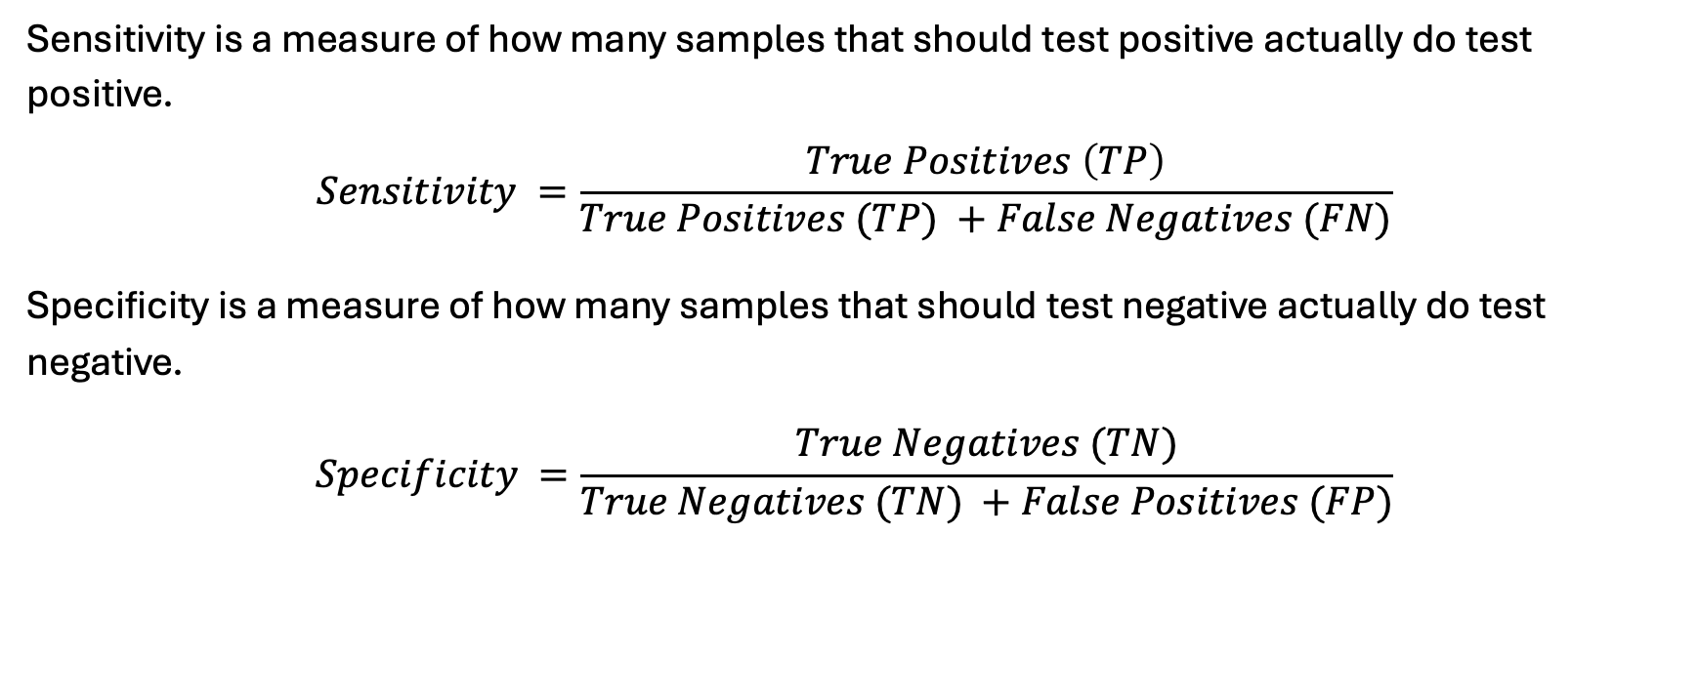
Sensitivity and specificity
Sensitivity is a measure of how many samples that should test positive actually do test positive.
$$Sensitivity =\frac{True Positives \left(TP\right)}{True Positives (TP) +False Negatives (FN)}$$
Specificity is a measure of how many samples that should test negative actually do test negative.
$$Specificity =\frac{True Negatives (TN)}{True Negatives (TN) +False Positives (FP)}$$

Slide 11
R code to calculate sensitivity and specificity
Notes:
Using a cutoff value of 500 , we can calculate the sensitivity and specificity:
R code:
# Define cutoff value
cutoff_value <- 500
# Create Seropos variable based on MFI cutoff
dat$Seropos <- ifelse(dat$MFI > cutoff_value, 1, 0)
# Calculate values for sensitivity and specificity
TP <- sum(dat$Seropos == 1 & dat$Pos_control == 1) # True Positives
TN <- sum(dat$Seropos == 0 & dat$Pos_control == 0) # True Negatives
FP <- sum(dat$Seropos == 1 & dat$Pos_control == 0) # False Positives
FN <- sum(dat$Seropos == 0 & dat$Pos_control == 1) # False Negatives
# Calculate Sensitivity and Specificity
Sensitivity <- TP / (TP + FN)
Specificity <- TN / (TN + FP)
# Print results
cat("True Positives:", TP, "\n")
cat("True Negatives:", TN, "\n")
cat("False Positives:", FP, "\n")
cat("False Negatives:", FN, "\n")
cat("Sensitivity:", round(Sensitivity, 3), "\n")
cat("Specificity:", round(Specificity, 3), "\n")
Write R code in one chunk. I have a df called dat, with variable Pos_control with 1 for positive controls and 0 for negative controls. I also have variable called MFI with a range of MFI values. Include cutoff_value <- 500. Create a variable called Seropos that is 1 if MFI > cutoff_value and 0 otherwise.
Then calculate the number of true positive, true negative, false positive, and false negative from this df. Then calculate Sensitivity and Specificity

Slide 12
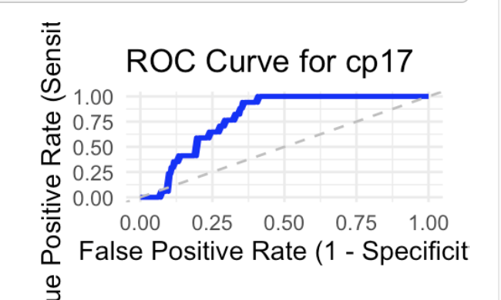
Making ROC Curves
The ROC curve uses sensitivity and specificity calculated at many different cutoff values
The ROC curve then plots We can apply a number of different cutoff values and calculate sensitivity and specificity at each cutoff value, and compare the results
ROC curves plot Sensitivity (which is true positive rate) on the y-axis and 1-Specificity (which is False positive rate) on the x-axis

Slide 13
R code to make ROC curve
Notes:
library(pROC) <- redo this in base R
roc_obj <- roc(response = dat$KnownStatus, predictor = dat$AntibodyLevel)
plot(roc_obj, print.auc = TRUE) # Plot ROC curve with AUC
Will controls be in 1 df together with pos/negative column, or should I join them together for this?

Slide 14
Choosing a cutoff from ROC Curve
The ROC curve shows us how sensitivity and specificity change as we adjust the cutoff value
We still must decide what cutoff to chose
Consider: Is it worse to have false negatives or false positives?
Is it worse to have false positives (labeling negative people as positive) like for a rare disease?
Is it worse to have false negatives (missing seropositive people)?
Are false negatives and positives equally bad?

Slide 15
Cutoffs from ROC curve – Youden’s Index
One common method method is Youden’s Index
This method finds the cutoff that maximizes Sensitivity + Specificity – 1
This method assumes false positive and false negatives are equally bad

Slide 16
Cutoffs from ROC curve – Youden’s Index
R code:
R code to show how to calculate and plot this
Show table of youden’s index at different cutoffs
Show roc plot with this point labeled
coords(roc_obj, "best", ret = "threshold") # Get optimal cutoff <- redo in base R

Slide 17
Cutoffs from ROC curve – other methods
Can also adjust the cutoff if we are more worried as false positives or false negatives, for example:
If we are concerned about too many false positives, we could set a minimum value for specificity
For example: cutoff with maximum sensitivity with >80% specificity
Most conservative: cutoff with maximum sensitivity with 100% specificity (cutoff is above value of highest negative control)

Slide 18
Cutoffs from ROC curve – other methods
R code showing how to apply methods to find cutoff with minimum specificity
Show table of results and roc curve with points identifiied

Slide 19
ROC curve summary
Advantages:
Flexible to prioritize sensitivity vs specificity
Disadvantages:
Requires positives and negatives
Controls may differ from sample population

Slide 20
Mixture models
Mixture models are the only method to calculate cutoffs directly from the sample distribution
Does not require positive or negative controls
We’ll go through some considerations for using this method but won’t go through the code
If you want to implement this method please ask outside of lecture

Slide 21
Mixture models
Advantage: Doesn’t require positive or negative controls
Disadvantage: Only works if we have distributions representing exposed and unexposed individuals with minimal overlap

Slide 22
Mixture models
Why may we not see two distinct distributions for exposed and unexposed individuals in a population (either 1 or 3+ distributions)?
Almost all/ almost no individuals exposed
Waning antibodies over time
Cross-reactive antibodies
Magnitude of antibody response could vary with intensity of infection
Natural infection vs. vaccination

Slide 23
Mixture models
Show histograms of good and bad distributions to apply this to.

Slide 24
Mixture models
Show number of components fit to different histograms

Slide 25
Mixture models
We can set this code in R to find the most probable 2 peaks in the sample distributions.
From this prediction of exposed and unexposed distributions, we can calculate most likely cutoff point.
For good distributions, show predicted humps
Share code to do this but don’t go through it.

Slide 26
Mixture models
Unlike other methods, this method does calculate a cutoff
Instead, it calculates the probability of each sample being seropositive based on the distributions
From these probabilities, you can calculate seroprevalence
Show table output of probbailiites

Slide 27
Conclusion
Be sure you understand the assumptions that come with each method of determining seropositivity
Show plot comparing results of different cutoff methods (cutoffs and seropositivity) for different antigens, histogram of samples with different cutoff methods labeled and fmm curves

Slide 28
Lab 4 Questions
What positive and/or negative controls do you have available? What was the source of these controls?
Using unexposed controls
Determine whether your negative controls are normally distributed. Calculate a cutoff value as mean + 2 or 3 standard deviations.
How are your negative controls similar/different to negatives in your population?
What is the seropositivity you calculated using negative controls as a cutoff?
ROC method:
Chose an MFI value and calculate sensitivity and specificity using positive and negative controls for an antigen.
Plot an ROC curve for this antigen.
How will you determine the best place on the ROC curve to establish a cutoff? What does this mean for how you weigh possible misclassification.
Using the ROC curve, what cutoff value did you use? Calculate seropositivity using this cutoff.
Optional: Plot your sample values and consider if they have a good distribution to fit a mixture model.
Compare results of all the cutoff methods you have applied. How similar / different are they?
Which method do you think you will use going forward in your study (if you will use a cutoff)? Why?
Notes:
Could give code to essentially answer lab questions for our example dataset

